Slide 1
Data Transformation

Slide 2
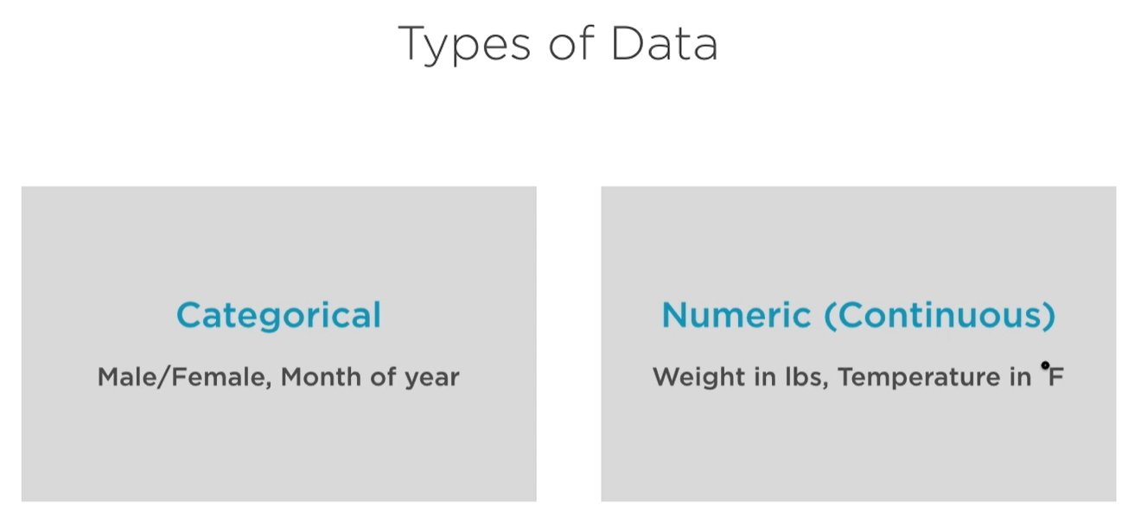
Types of Data

Slide 3
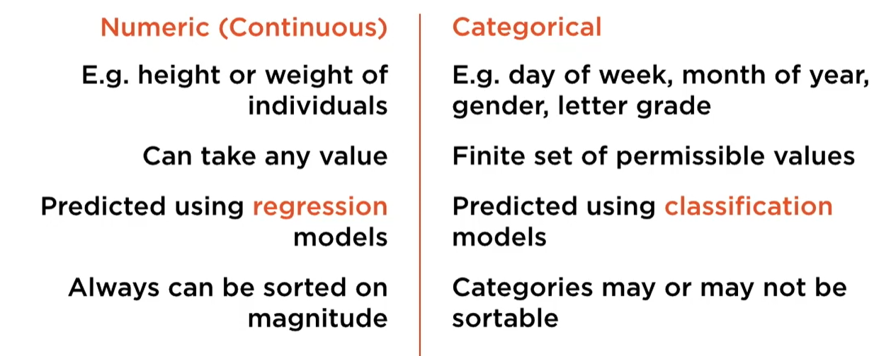
Comparison between numeric and Categorical
If predicted output is numeric use regression if it is categorical use classification.

Slide 4
Why Feature Scaling is required?
When range of all features are not same and Machine learning models work best when the range of the features are same.
Basically we scale all the numeric features.

Slide 5
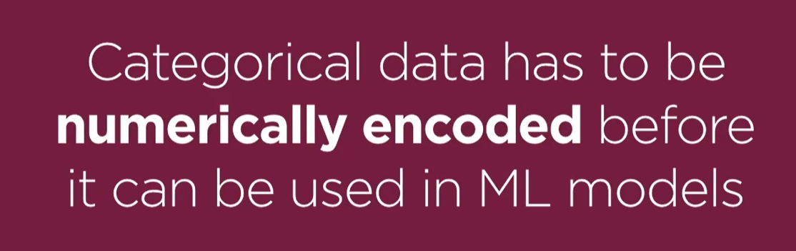
Why we need to encode Categorical features?

Slide 6
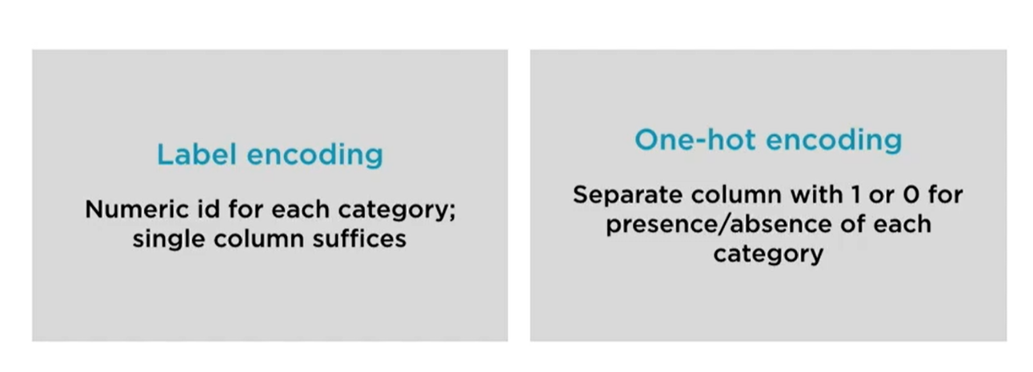
When categories are nominal
Like City:[Mumbai,Kolkata,Pune,Banglore]

Slide 7
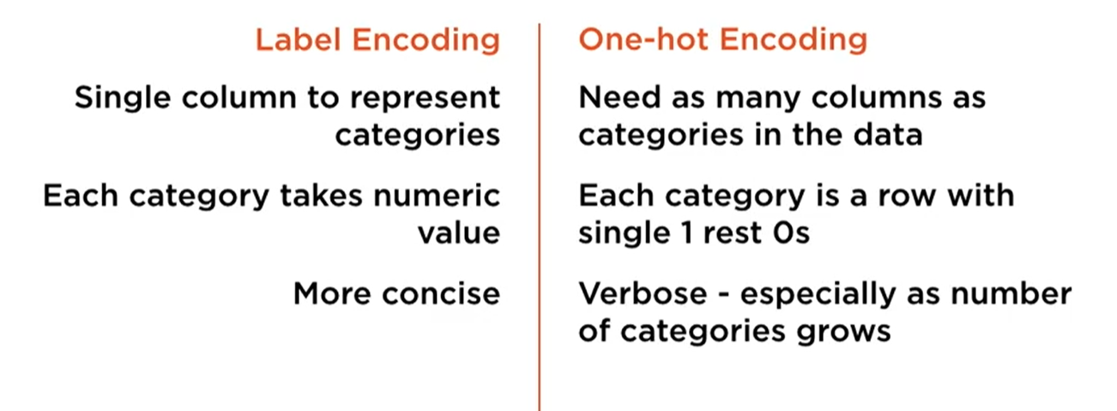
Label Encoding vs One-Hot Encoding

Slide 8
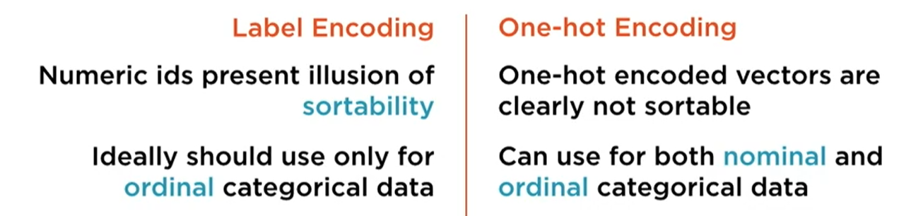
Label Encoding vs One-Hot Encoding

Slide 9
Discretization of numerical features
To simplify the continuous data we often perform discretization or bucketing in our features,This process is called Discretization of Continuous features.
E.g – we have a feature “Age” and we have values like (18,17,22,25,45,67) , now we want to divide these data into three categories “Teenager”,”Middle-aged”,”Old”.So to do that we need to use discretization.

